Slide 1
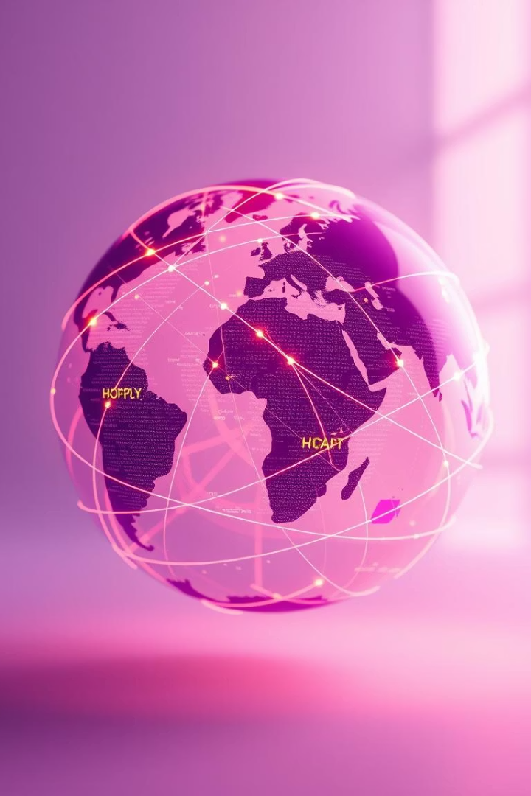

Mapping Global Commitment to the SDGs: A Predictive Approach
Unveiling global cooperation for a sustainable future.
GA
2 Contributors

Slide 2
The Persistent Challenge: Hunger and Poverty
Despite global efforts, hunger and poverty remain widespread. Unequal commitment hinders progress.
Lack of collaboration between nations exacerbates these critical issues. A new approach is needed.

Slide 3

Our Solution: Predictive ML for SDG Collaboration
Track & Analyze
Identify Gaps
Monitor real-time global cooperation on SDGs.
Pinpoint countries with low participation.
Predict & Engage
Forecast future commitment and drive action.

Slide 4

Dataset Overview: Fueling Our Insights
Source
Kaggle (SDG Commitment)
Indicators
Poverty, hunger, partnerships
Granularity
Country-level, yearly data
This dataset provides comprehensive insights into global SDG commitment, with key features including poverty rates, hunger indices, and international partnership data, all structured at a country-level, yearly granularity.

Slide 5
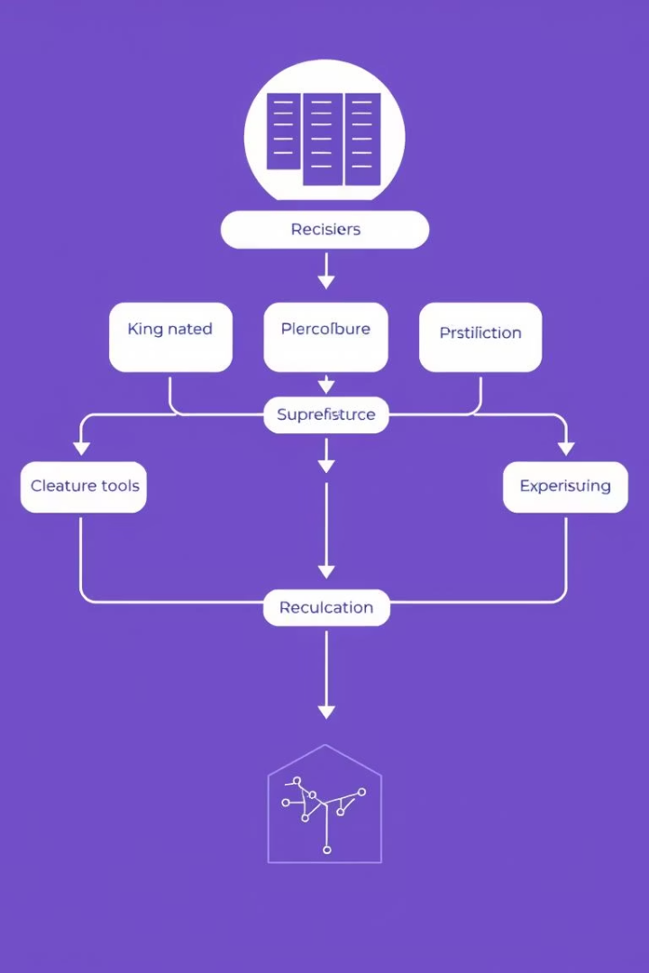




Methodology: From Data to Prediction
Data Cleaning
Ensuring data quality and consistency.
Feature Selection
Identifying key variables for modeling.
Model Training
Utilizing clustering and classification.
Performance Metrics
Evaluating accuracy and reliability.

Slide 6
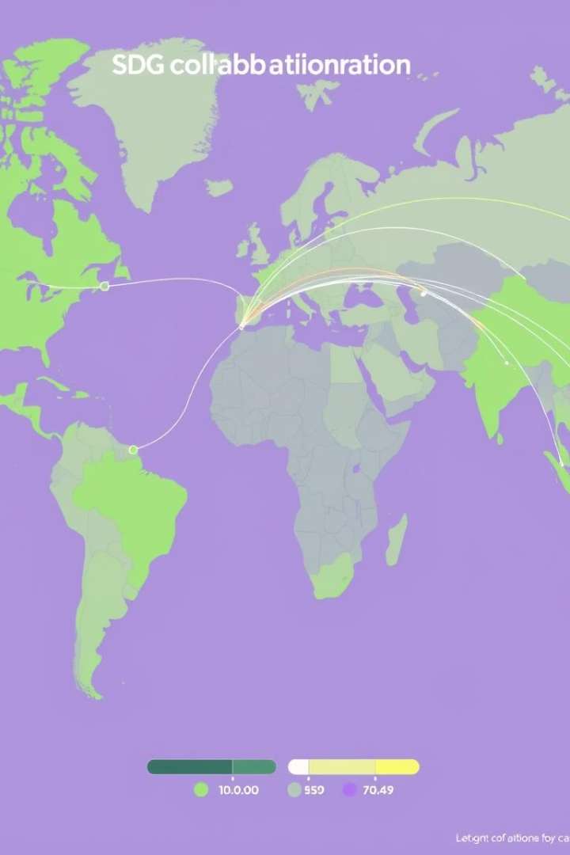
Key Findings: Identifying Collaboration Patterns
Our model highlights distinct collaboration patterns. Leading countries demonstrate consistent engagement.
Non-participating nations often face unique socio-economic barriers. Targeted interventions are crucial.

Slide 7






Impact: Driving Greater SDG Participation
NGOs
Focus interventions on vulnerable areas.
Governments
Prioritize resource allocation effectively.
Citizens
Advocate for stronger national commitments.

Slide 8

Next Steps & Call to Action
Scale Globally
Expand model to include all SDGs.
Real-time Tracking
Implement dynamic data updates.
Integrate More Indicators
Enhance predictive accuracy further.
We invite you to join us in this critical mission. Your support can transform global commitment into tangible action. Let's work together for a sustainable future.

